Slide 1




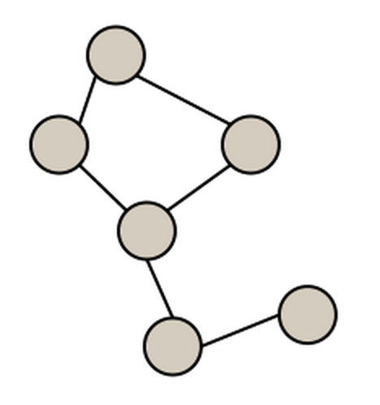
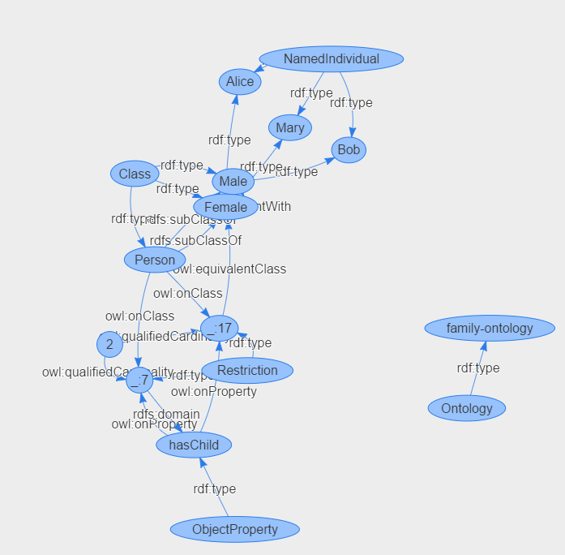





Web-based Ontology Analysis and Partitioning Tool
Overview
Application Workflow
With the increasing use of ontologies in many branches of science and industry not only the number of available ontologies has increased considerably but also many widely used ontologies have reached a size that overburdens development and quality control procedures. It has been argued that the maintenance of large ontologies would be greatly facilitated by decomposing large ontologies into smaller modules that cover certain subtopics of the ontology. To accomplish this, the “Web-based ontology analysis and partitioning tool” is developed as an open platform web application. Its design allows for quickly uploading large ontologies and partitioning the ontologies into smaller modules.
Architecture
Input
Frontend
(AngularJS)
Backend
(Node.js)
ONTOLOGY
Upload
Extract RDF
G1
Partitioning
Translate
Graph (G)
Metrics
G2
G3
Request
Internal graph representation
133 Classes
Response
400 Properties
Implementation Details
Output
671 Individuals
Graph (G)
{G1,G2,….,Gn}
The tool is a web-based application running on the MEAN stack (without MongoDB) having Java 1.7 as a dependency.
Software used:
Express,js v4.13.3
Angularjs v1.3.15
Node.js v0.12.2 (release date May 2015).
Furthermore, other Node.js modules are used to ease the development and to accomplish different functions, such as file handling.
The semantic web specific libraries used are:
RDFSTORE
VisJS
OWL2VOWL
RDF TEXT FORMAT
Export
Partitioner
Results
Conversion of the ontology into RDF triples
Visualization of triples as a directed graph
Metrics that count specific elements of the graph
Filtering & highlighting
Random colors and shapes to highlight
Partitioning
Saving the result as a file
Virtual Machine and Remote Access
Workstation name : EIS03
OS: Windows (64 bit) ; Base memory : 4096MB
Source code and Documentation
https://github.com/EIS-Bonn/MA-INF3232-Lab-SS2015.git
Image - Visualized Ontology
19^{h} October, 2015

